Slide 1
Mobile Application Development
Components of an android application

Slide 2
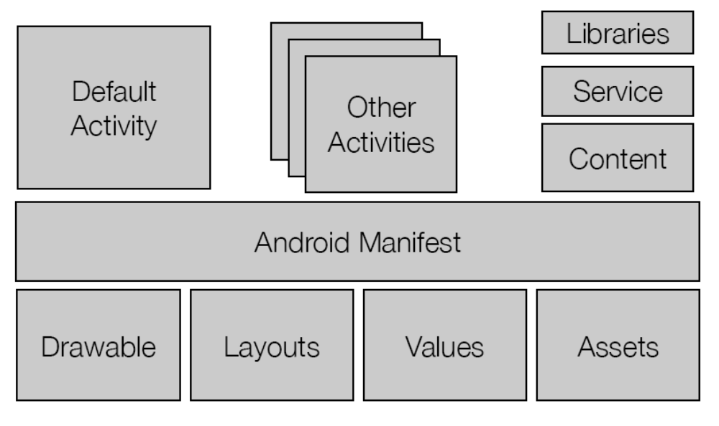
Components of android application
An android application is made up of several components ,
These components are also known as building blocks or application frame work elements.
They include the following :
  Content Providers
  Windows
  Activities
  AndroidManifest.xml
  Intents, Intent Filter and intent receivers
  Services
  Layouts
  Broadcast receivers

Slide 3
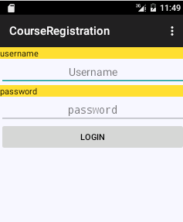
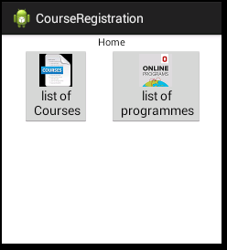
1. Activity
An activity is a class that presents a visual user interface (screen) for one task the user can do.
A user can move through screens by starting other activities.
• Examples:
An activity for displaying buttons for
Allowing user to select an option
An activity presenting login screen

Slide 4
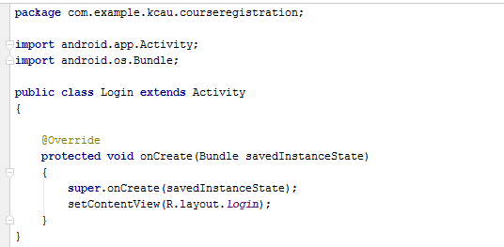
Activities
Implementing an activity

Slide 5
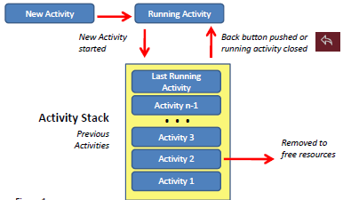
Activity stack
Activities are stacked (arranged) like a deck of cards
New activities are placed on top and only one activity is visible at a time.

Slide 6

2. Intent
An intent is a message that describes a desired action, data to be acted upon, and the category of component that should perform the action
Intent is mostly used to launch specific activities e.g. send an email, view user contacts

Slide 7


3. Service
A Service is a class without a visual interface so that it an be executed in the background.
Service do not interact with the user
It is usually used for performing long tasks.
A service can be implemented as follows:
Example
Music player: Keeps playing even though user is navigating to other parts of the application
Searching Service: that fetch data over the network without blocking user interaction with an activity.

Slide 8
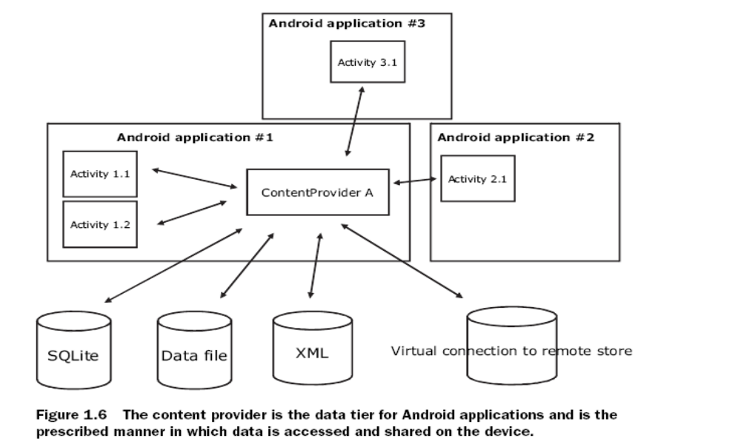

4. Content Provider
Content providers are objects that can retrieve and store data in data storage mechanism such as SQLite or datafile
SQLite is an optimized dbms that runs on android .
Content Provider enables applications to share data.
It is the only way to share data across packages.
For Example, any application can access the contacts database

Slide 9

4. Content Provider
Sample code for creating content provider:

Slide 10
5. Android Manifest File
An android application must have android manifest file, which is Generated automatically. Its functions include:
1. Describes application components such as activities, intents, services, Notifications and content etc.
2. Declares the name of java package for the application.
3. Declares the minimum version of android sdk (minsdk) that is required to run the application.
4. Declares the permissions that application must have in order to access some APIs or other application.
5. It declares the permission that others are required in order to access it's own components.

Slide 11
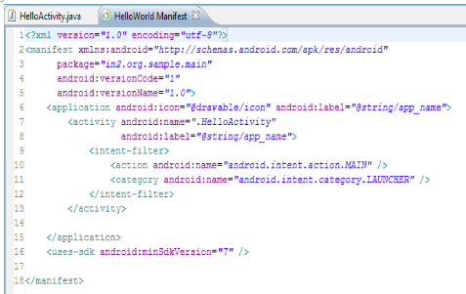
5. Android Manifest File: Example

Slide 12
6. Broadcast Receivers
Broadcast Receiver is a class that receive and react to broadcast intents.
It is implemented as a subclass of BroadcastReceiver class and each message is broadcasted as an Intent object.
Examples of Broadcast intents are:
Low battery, power connected, shutdown, timezone changed, etc.

Slide 13

6. Broadcast Receivers
Sample Code for creating a broadcast:
Applications can initiate broadcasts by passing to any of the following methods:
  Context.sendBroadcast(Intent intent)
  Context.sendOrderedBroadcast(),
  Context.sendStickyBroadcast()

Slide 14
7. Resources
Resources refers to external elements that are used or shared by components of the application.
They include strings, constants and Drawable pictures.

Slide 15
8Layouts
Layouts refers to ViewGroups that control format and appearance of the views.
Examples are:
  Linear layout
  Relative layout,
  Table layout,
  Grid layout
  and tab layout

Slide 16

End
Thank You
Questions

